Slide 1
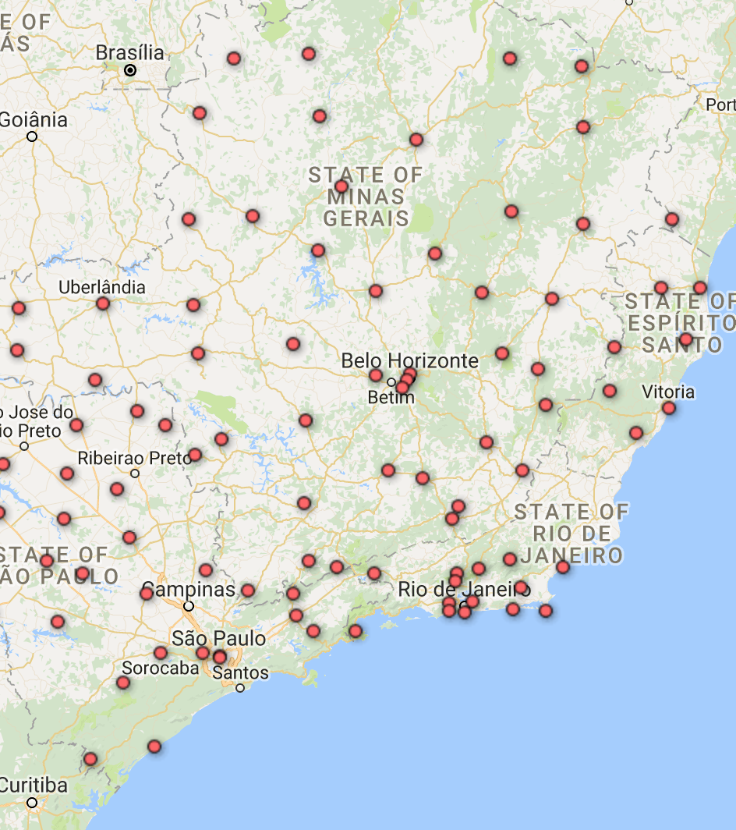
Hourly Weather Surface – South Brazil

Slide 2
Data Description
The Train Data contains hourly weather data.
Collected from 105 weathers stations of a southeast region in Brazil.
Between 2000-2016.
Contain 29 variables and 7,246,083 observation.
Project’s Goal - Build a model that will predict the Temperature.

Slide 3
Independent Variables
IDs Variables - Station ID, City, lon and lat and State
Date Variables- date, year, month, day and hour
Continues Variables- Amount of precipitation, Air pressure, Solar radiation, humid and etc.

Slide 4
EDA & Interpolation

Slide 5
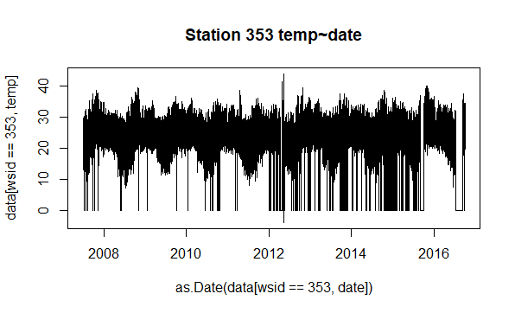
Station Temperature by Date

Slide 6
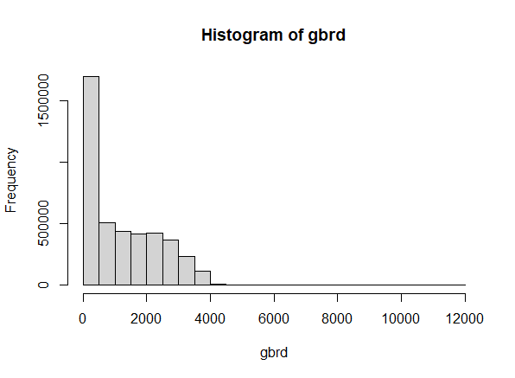

gbrd
Solar radiation.
The number of NA’s in the data is high (almost 50%).
There isn’t solar radiation at night, so we can replace the NA with 0.

Slide 7
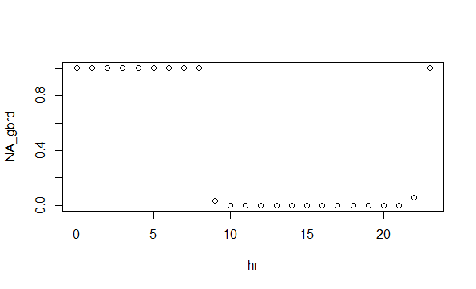
gbrd by hours

Slide 8
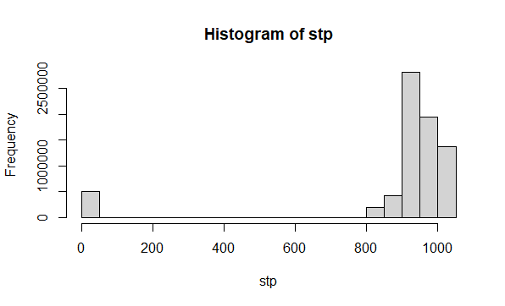

stp
Air pressure for the hour.
There is outliers in the data.
We can see it via the big gap between in the distribution of stp.

Slide 9
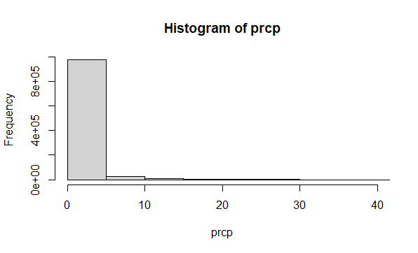

prcp
Amount of precipitation.
Like gbrd, the number of Na’s is very high 85%.
In contrast to the gbrd, there isn’t a pattern of the NA’s in prcp (for example- o precipitation in the summer).

Slide 10
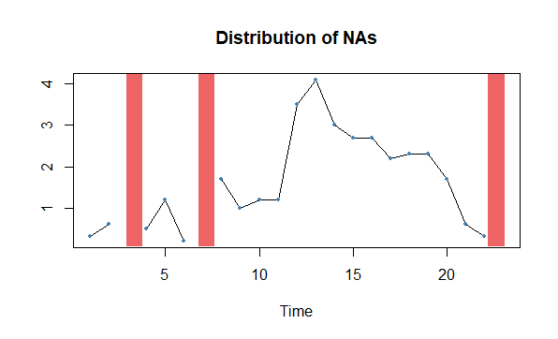
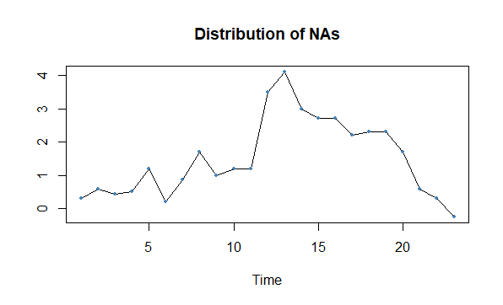
TS Interpolation
Time Series Imputation:
Linear
Spline
Stine

Slide 11
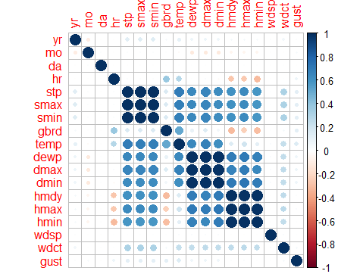
Correlation Matrix
Multicollinearity
No Correlations

Slide 12
Modeling
Random Forrest
Adaboost
XGboost

Slide 13
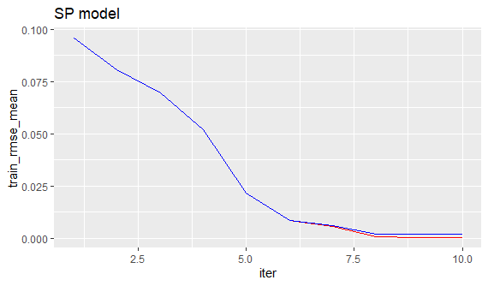
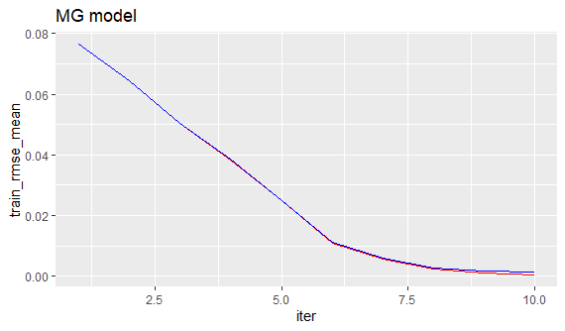
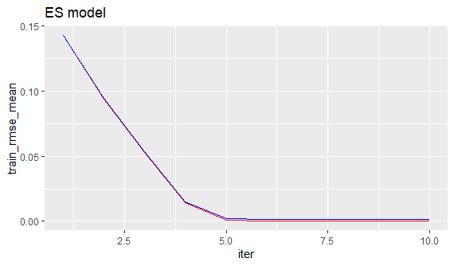
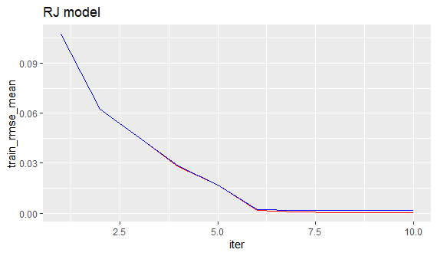
Xgboost Models- by State

